Slide 1


T. C.
ANKARA UNIVERSITY
ENGINEERING FACULTY
COMPUTER ENGINEERING DEPARTMENT
AN INTRUSION DETECTION SYSTEM
FOR NEW CYBER ATTACKS
Ayça Nur VANLI
SUPERVISOR
Asst. Prof. Ömer Özgür TANRIÖVER

Slide 2
Table of Contents
INTRODUCTION
1.1. WannaCry
2. HOST-BASED IDS
3. NETWORK IDS
3.1. Distinctive Data Split
3.2. Inclusive Data Split
4. DEMONSTRATION

Slide 3
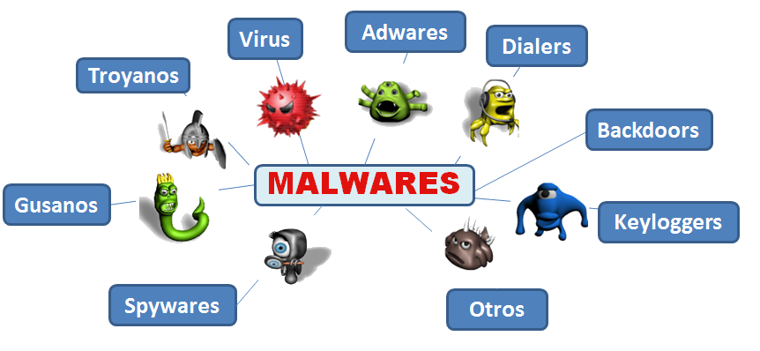
1. Introduction

Slide 4

1.1. WannaCry

Slide 5
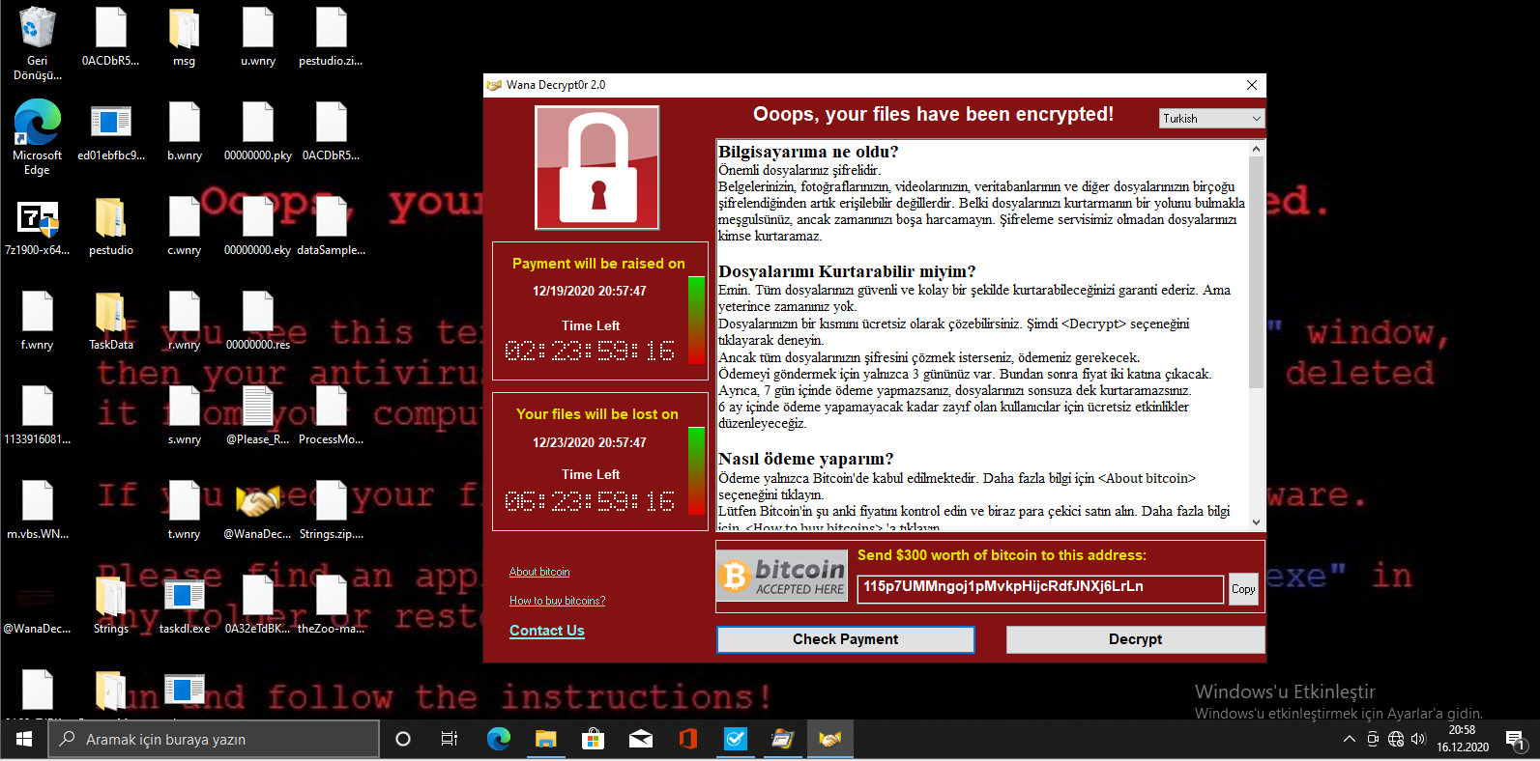
1.1. WannaCry

Slide 6
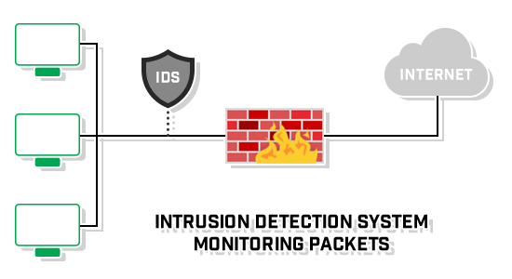
1. Introduction

Slide 7
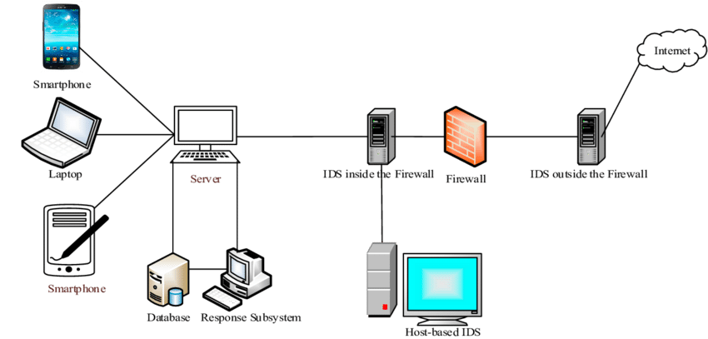
1. Introduction
2
Network IDS
1

Slide 8
2. Host-Based IDS
Malware = theZoo in GitHub
PE Headers → DLL calls → List of Imported DLLs
TF-IDF
TF = Term Frequency
(How many times it occurs in a document)
IDF = Inverse Doucment Frequency
(How many documents it occurs at)

Slide 9




2. Host-Based IDS
That equation gives weights to each DLL import.
Crypto Library → Ransomware
Socrates → Philosophy

Slide 10
2. Host-Based IDS
FPR < 0.2
Increasing Threshold in Each Iteration

Slide 11
3. Network IDS
CICIDS2017

Slide 12
3. Network IDS
Label Name | Number
Benign | 1
DDoS | 2
PortScan | 3
Bot | 4
Infiltration | 5
Brute Force | 6
XSS | 7
SQL Injection | 8
FTP-Patator | 9
SSH-Patator | 10
DoS slowloris | 11
DoS slowhttptest | 12
DoS Hulk | 13
DoS GoldenEye | 14
Heartbleed | 15
CICIDS2017
Isolation Forest for Anomaly Detection

Slide 13
3.1. Distinctive Data Set
Data Set | Benign Samples | Attack Types | Malicious Ratio (Contamination Ratio)
Train | Yes | 2,3,4,5,6,7,8,9,10 | %15.25450159
Valid | Yes | 10,11,12,13 | %46.10078401
Test | Yes | 13,14,15 | %14.04246701

Slide 14
3.1. Distinctive Data Set

Slide 15
3.1. Distinctive Data Set
Interesting Point:
Data Set | Main Attack Type | Main Attack Type Percentage | Intersection with Train Data Set | Intersection Attack with Train Data Set
Valid | DoS | %98,61915003397208 | %0,0138084996602792 | SSH-Patator
Test | DoS | %99,98155167208936 | %0 | None

Slide 16
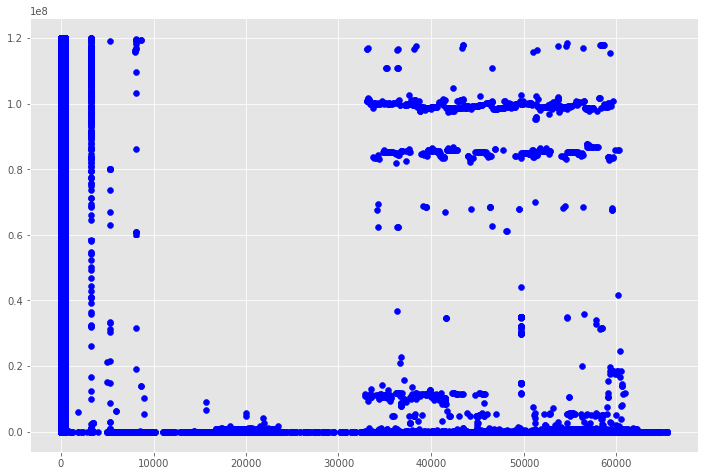
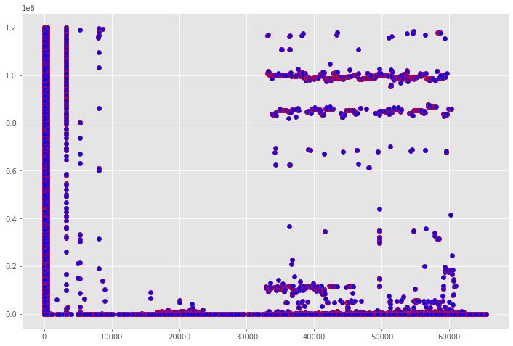
3.1. Distinctive Data Set

Slide 17
3.2. Inclusive Data Set
Label | Train | Valid | Test
Benign | 1363105 | 454126 | 454089
DDoS | 76789 | 25648 | 25588
PortScan | 95220 | 31872 | 31712
Bot | 1204 | 366 | 386
Infiltration | 22 | 9 | 5
Brute Force | 929 | 287 | 291
XSS | 383 | 147 | 122
Sql Injection | 10 | 6 | 5
FTP-Patator | 4804 | 1561 | 1570
SSH-Patator | 3514 | 1141 | 1242
DoS slowloris | 3473 | 1177 | 1146
DoS slowhttptest | 3280 | 1116 | 1103
DoS Hulk | 137797 | 46068 | 46259
DoS GoldenEye | 6189 | 2049 | 2055
Heartbleed | 6 | 2 | 3
Total | 1696725 | 565575 | 565576

Slide 18
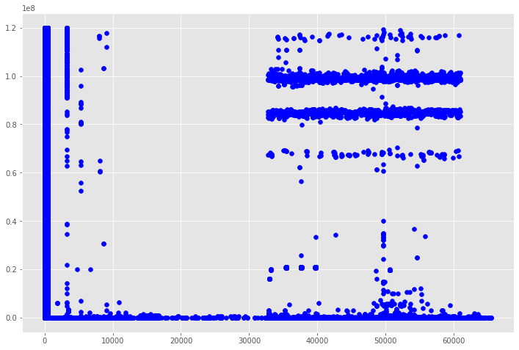
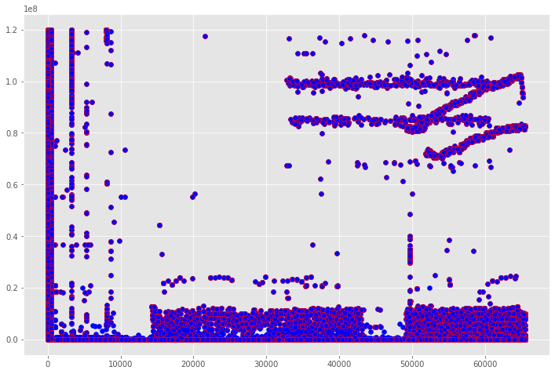
3.2. Inclusive Data Set

Slide 19
3.2. Inclusive Data Set

Slide 20
4. Demonstration
GitHub Repository: https://github.com/aycavanli/IDS

Slide 21
Thank You for Listening
Contact Information
Email: aycavanli@gmail.com
Linkedin: Ayca Nur VANLI

